Slide 1

Mobile Security - Android Instrumentation using Frida
by Lukas Treffner & Hans-Jürgen Kleeberger

Slide 2
Frida - Overview
Open-source dynamic instrumentation framework for Android, iOS, Linux Windows, and macOS
Allows analyzing and manipulating application behavior by providing an easy-to-learn scripting interface
Scripts can be injected during application runtime
Relies on a client-server architecture by injecting the “frida-server” into the target process being the server and using “frida-tools” as the client.

Slide 3
Frida – Usecases
for tracing method invocations of target applications
for modifying and observing application behavior
by modifying or logging argument/return values of instrumented methods

Slide 4
Frida – CLI
frida-ps
Lists all processes
frida-discover
Lists all function calls in an app
frida-ls-devices
Lists attached devices
frida-kill
Kills a process

Slide 5
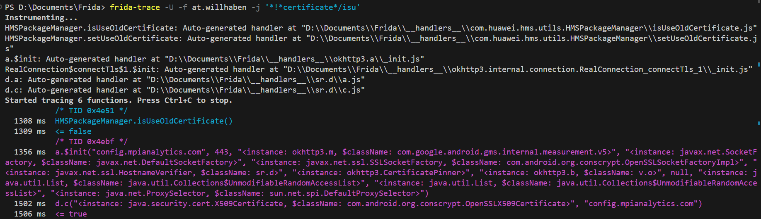
Frida CLI – “frida-trace”
allows to instrument processes without the need of writing dedicated scripts

Slide 6
Certificate Pinning Fixer
Adding pinning an already built android application
Use of network security config pinning
No need to rebuilt/know/have source code
No interference with original implementation

Slide 7
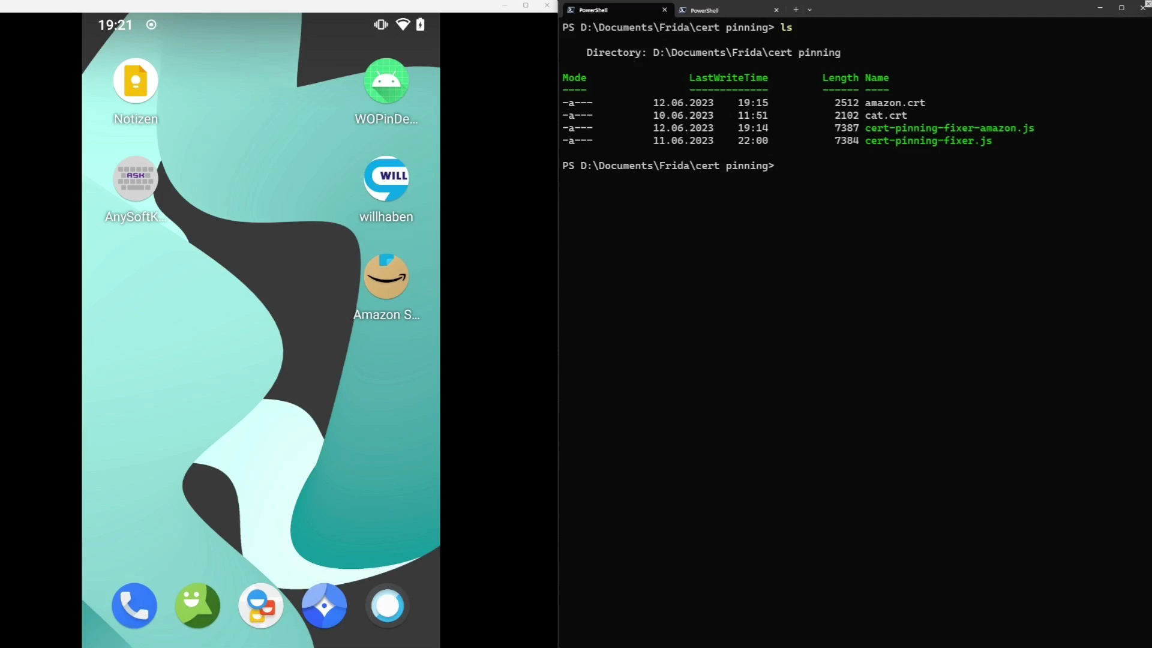
Demo

Slide 8
Keylogger
Focus on AnySoft Keyboard
Simple logging of user input
Outputting user input in python script

Slide 9
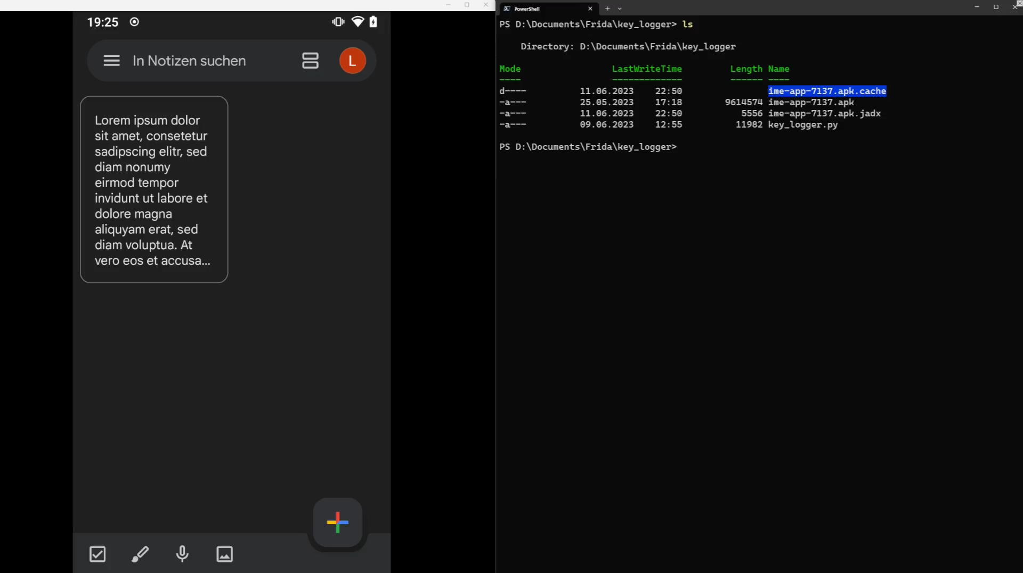
Demo

